Slide 1

Green Pace
Security Policy Presentation
Developer: Connie Knupp

Slide 2

OVERVIEW: DEFENSE IN DEPTH
Why is standardized security essential? Growing threats
According to the United States Department of Homeland Security, technological advances combined with the growing risks related to artificial intelligence require unshakable diligence and increased versatility to face the cyber threats of today. (Shields ready, n.d.)
Defense in depth (DiD)
Layered approach to security
Strategy designed to provide more robust coverage of vulnerabilities.
This security policy will primarily address the crucial “APP Security” layer of security by defining:
core security principles
coding standards
AAA
data encryption policies.

Slide 3
THREATS MATRIX
Likely MSC-002-CPP – no return value when expected MSC-001-J – Inappropriate use of assertions | Priority MEM-001-CPP - Memory allocation errors INT-001-CPP – Integer buffer overflow IDS-001-J – SQL injection STD-001-CPP – Insuffient string storage
Low priority ERR-001-CPP – Unhandled exceptions | Unlikely FIO-001-CPP – Unclosed files / memory leaks EXP-001-CPP –Using uninitialized memory STR-002-CPP- Invalid pointers or iterators for a string
Increasing Likelihood
Increasing Severity

Slide 4
10 PRINCIPLES
The top 10 secure coding principles are displayed below with the coding standards that map to each principle.
Validate input
STR-001-CPP
INT-001-CPP
IDS-001-J
MEM-001-CPP
Heed compiler warnings
STR-001-CPP
Architect and design for security policies
IDS-001-J
MEM-001-CPP
MSC-002-CPP
Keep it simple
Default deny
Adhere to the principle of least privilege
Sanitize data sent to other systems
IDS-001-J
Practice defense in depth
Use effective quality assurance techniques
Adopt a secure coding standard
STR-001-CPP
INT-001-CPP
STR-002-CPP
IDS-001-J
MEM-001-CPP
MSC-001-CPP
ERR-001-CPP
FIO-001-CPP
EXP-001-CPP
MSC-002-CPP
(Seacord, 2018)

Slide 5
CODING STANDARDS
The standards are ranked below according to priority.
MEM-001-CPP – “Detect and handle memory allocation errors” (Pincar, 2025c).
INT-001-CPP – “Ensure that operations on signed integers do not result in overflow.” (Seacord, 2025)
IDS-001-J – “Prevent SQL injection” (Mohindra, 2025).
STR-001-CPP – “Guarantee that storage for strings has sufficient space for character data and the null terminator” (Mariani, 2025a).
EXP-001-CPP – “Do not read uninitialized memory” (Pincar, 2025a).
STR-002-CPP – “Use valid references, pointers, and iterators to reference elements of a basic_string” (Mariani, 2025b).
MSC-002-CPP – “Value-returning functions must return a value from all exit paths” (Ballman, 2025b).
ERR-001-CPP – “Handle all exceptions” (Ballman, 2025a).
FIO-001-CPP – “Close files when they are no longer needed” (Pincar, 2025b).
MSC-001-J – “Do not use assertions to verify the absence of runtime errors” (Long, 2023).
Priority = severity (1- 4) * likelihood (1-3) * remediation cost (3-1) together.
**For severity and likelihood 1 is low and 3 or 4 is high, but the value for remediation cost is inverted, 3 is low and 1 is high.**

Slide 6
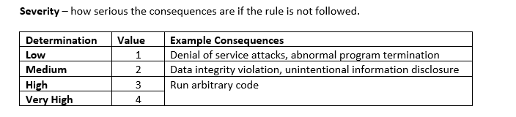
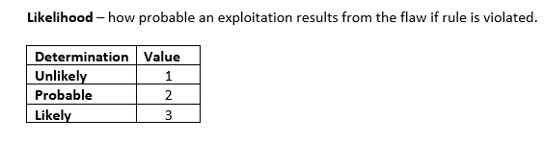
RISK ASSESSMENT
Priority = severity * likelihood * remediation cost

Slide 7
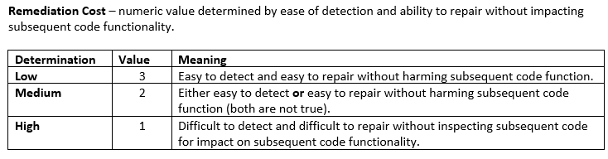
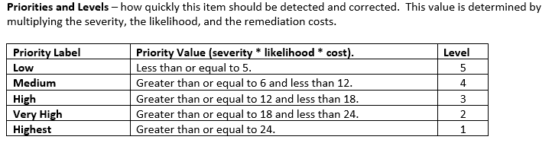
RISK ASSESSMENT
Priority = severity * likelihood * remediation cost

Slide 8
ENCRYPTION POLICIES
Encryption at Rest
Data is considered at rest when it is being stored, not actively being utilized.
Needs to be encrypted.
This policy adds an additional layer of data in the event a malicious attacker gains access to the stored data.
Green Pace will utilize AES-256 to encrypt all data at rest
Security team will be responsible for creating and managing encryption keys.
Encryption in Flight
Data is considered in flight when it is in transit.
Moving through the system
Moving outside of the system
Encryption in flight is a policy that states data in transit will be encrypted
transport layer security (TLS)
virtual private networks (VPNs)
SSH file transport protocol (SFTP).
Green Pace will utilize encryption in flight for all data in transit.
The security team will be responsible for creating and managing keys.

Slide 9
ENCRYPTION POLICIES
Encryption in Use
Data is considered in use when it is actively being utilized by the system.
Encryption in use is a policy that states data in use will be encrypted
Homomorphic encryption
Secure multi-party computation
Encryption in use will be used by Green Pace for all sensitive data like passwords or account numbers.

Slide 10
TRIPLE-A POLICIES
Authentication
Ensures the user is who they claim to be.
Multifactor authentication
All users who are attempting to access the system.
Username/Password or matching biometrics.
One-time use code
Authorization
What activities a user is allowed to utilize.
Minimum privilege needed for all users.
Monitored for excessive changes that indicate the system is compromised.
Accounting
Logging and tracking services to accessed
Monitored for unusual activity.
Helpful data used in recovery from attack.

Slide 11

Unit Testing
Creating unit tests is an important part of the software design process.
Finds errors earlier
Less cost associated.
Tests can be rerun after any software updates
Verifies the new code does not break existing functionality.
Results are pass or fail. This failed test was created to demonstrate how it looks when a test fails.

Slide 12
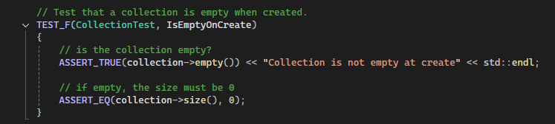
Is Empty on Create
Tests that a collection is empty when created. Notifies user of error if not.
Positive test – expects code works as intended and results are true for both assertions.
Test
Results

Slide 13
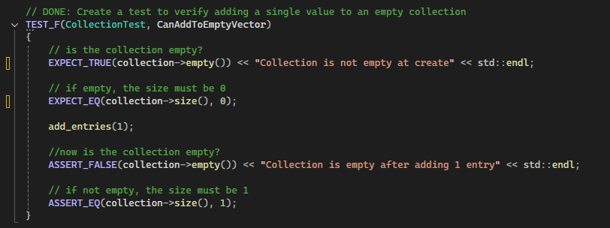
Can Add to an Empty Vector
Verifies the ability to add a single value to an empty collection. Notifies user of error if not.
Test
Results

Slide 14
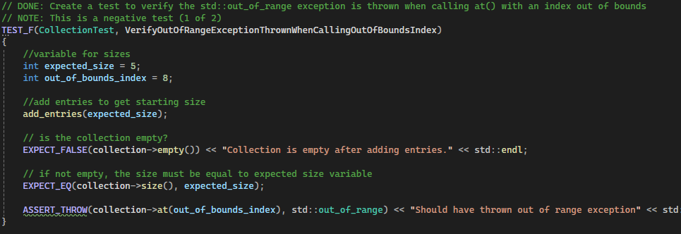
Out of Range Exception Thrown When Calling Out of Bounds Index
Verifies the standard exception is thrown when calling with an out of bounds index. Notifies user of error if not.
Negative Test – Tests how code handles errors, in this case throws expected exception.
Test
Results

Slide 15
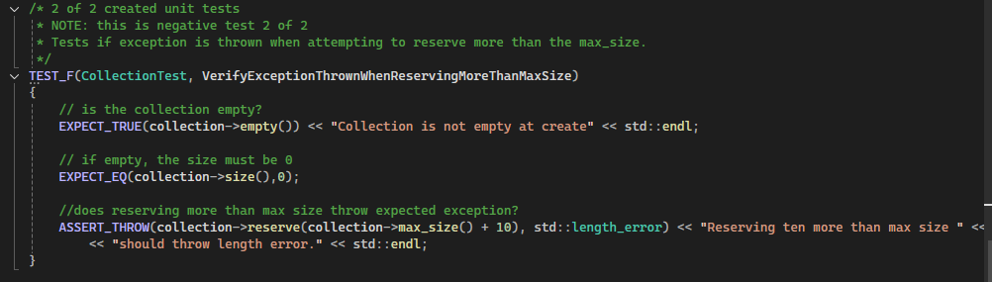
Out of Range Exception Thrown When Reserving More than Max Size
Verifies the standard length_error exception is thrown when reserving more than the max size is attempted. Notifies user of error if not.
Negative Test – Tests how code handles errors, in this case throws expected exception.
Test
Results

Slide 16

AUTOMATION SUMMARY

Slide 17
TOOLS
DevSecOps pipeline is a continuous loop for software development that focuses on security at every stage.
Preproduction
Assess and plan – analyze threats to security
Design and build – follows secure standards
OWASP
Security policy
Verify and testing
Tests to ensure not vulnerable to known threats.
Static Analysis Tools
Astree, CPPcheck, Clang, etc.
Unit tests
jUnit
Production
Transition and health check
Verify secure settings
Intrusion testing
Dynamic Application Security Testing tools
Monitor and detect
Log activities
Detect abnormal activity
Security Information and Event Management Tools
Respond
In the event of the attack
Halt operations
Block attackers
Maintain and Stabilize
Verify back to normal security baseline.

Slide 18
RISKS AND BENEFITS
Acting immediately to focus on security is in the best interest of our company as well as ourselves.
Risks of waiting
Increase likelihood that a vulnerability is exploited.
Loss of trust
Cost of attack
Increased cost on projects when errors are found later in development.
Increased production time when errors found late in development.
Risks of implementing immediately
Tough learning curve for developers
Complexity of code may increase
Benefits of implementation
Less risk to the individuals and the company.
Lower cost when vulnerabilities are detected and corrected early
Professional development
Better quality products

Slide 19
RECOMMENDATIONS
This policy started with the top 10 principals and standards; the primary recommendation is to expanded the policy to include emerging threats and existing threats not included in the current top 10.
Several more listed on for every language on the Carnegie Mellon University Software Engineering Institute.
Emerging threats due to developing AI and technology advances
Steps to be taken
Implement encryption where it is missing.
Old servers with data stored unencrypted should be brough to standards.
Answer any questions that are brough forward by developers learning new policy.
Evaluate existing software projects to determine if updates to improve security are needed.
Example: Are all systems multifactor authentication?
Create incident response procedures
Who is notified?
Guidelines on when to shutdown and/or rollback
Follow security policy in all projects moving forward.
Provide continuing education on secure practices.

Slide 20
CONCLUSIONS
In conclusion moving forward Green Pace will adopt secure coding best practices and standards outlined in the security policy.
Includes:
AAA
Encryption standards
Rest
Flight
In Use
Defense in depth
Top 10 security principles
Coding standards depicted
Green Pace commits to continually improving our security policy and adhering to industry best practices.

Slide 21
REFERENCES
Ballman, A. (2025a, July 21). Err51-CPP. handle all exceptions. Carnegie Mellon University: Software Engineering Institute. https://wiki.sei.cmu.edu/confluence/display/cplusplus/ERR51-CPP.+Handle+all+exceptions
Ballman, A. (2025b, July 8). MSC52-CPP. value-returning functions must return a value from all exit paths. Carnegie Mellon University: Software Engineering Institute. . https://wiki.sei.cmu.edu/confluence/display/cplusplus/MSC52-CPP.+Value-returning+functions+must+return+a+value+from+all+exit+paths
Long, F. (2023, January 10). MSC60-J. Do not use assertions to verify the absence of runtime errors. Carnegie Mellon University: Software Engineering Institute. https://wiki.sei.cmu.edu/confluence/display/java/MSC60-J.+Do+not+use+assertions+to+verify+the+absence+of+runtime+errors
Mariani, F. (2025a, August 6). Str31-C. Guarantee that storage for strings has sufficient space for character data and the null terminator. Carnegie Mellon University: Software Engineering Institute. https://wiki.sei.cmu.edu/confluence/display/c/STR31-C.+Guarantee+that+storage+for+strings+has+sufficient+space+for+character+data+and+the+null+terminator
Mariani, F. (2025b, July 2). Str52-CPP. Use valid references, pointers, and iterators to reference elements of a basic_string. Carnegie Mellon University: Software Engineering Institute. https://wiki.sei.cmu.edu/confluence/display/cplusplus/STR52-CPP.+Use+valid+references%2C+pointers%2C+and+iterators+to+reference+elements+of+a+basic_string
Mohindra, D. (2025, August 6). IDS00-J. Prevent SQL Injection. Carnegie Mellon University: Software Engineering Institute. https://wiki.sei.cmu.edu/confluence/display/java/IDS00-J.+Prevent+SQL+injection

Slide 22
REFERENCES
Pincar, J. (2025a, July 25). Exp53-CPP. do not read uninitialized memory. Carnegie Mellon University: Software Engineering Institute. https://wiki.sei.cmu.edu/confluence/display/cplusplus/EXP53-CPP.+Do+not+read+uninitialized+memory
Pincar, J. (2025b, July 2). Fio51-CPP. close files when they are no longer needed. Carnegie Mellon University: Software Engineering Institute. https://wiki.sei.cmu.edu/confluence/display/cplusplus/FIO51-CPP.+Close+files+when+they+are+no+longer+needed
Pincar, J. (2025c, June 25). Mem52-CPP. detect and handle memory allocation errors. Carnegie Mellon University: Software Engineering Institute. https://wiki.sei.cmu.edu/confluence/display/cplusplus/MEM52-CPP.+Detect+and+handle+memory+allocation+errors
Seacord, R. (2025, May 5). INT32-C. ensure that operations on signed integers do not result in overflow. Carnegie Mellon University: Software Engineering Institute. https://wiki.sei.cmu.edu/confluence/display/c/INT32-C.+Ensure+that+operations+on+signed+integers+do+not+result+in+overflow
Seacord, R. (2018, May 2). Top 10 secure coding standards. Carnegie Mellon University: Software Engineering Institute. https://wiki.sei.cmu.edu/confluence/display/c/INT32-C.+Ensure+that+operations+on+signed+integers+do+not+result+in+overflow
United States Government. (n.d.). Shields ready. Cybersecurity and Infrastructure Security Agency CISA. https://www.cisa.gov/shields-ready

